Slide 1
ARGO Project
By Axel Amzallag, Tim Kalnins, and Joshua Hug

Slide 2
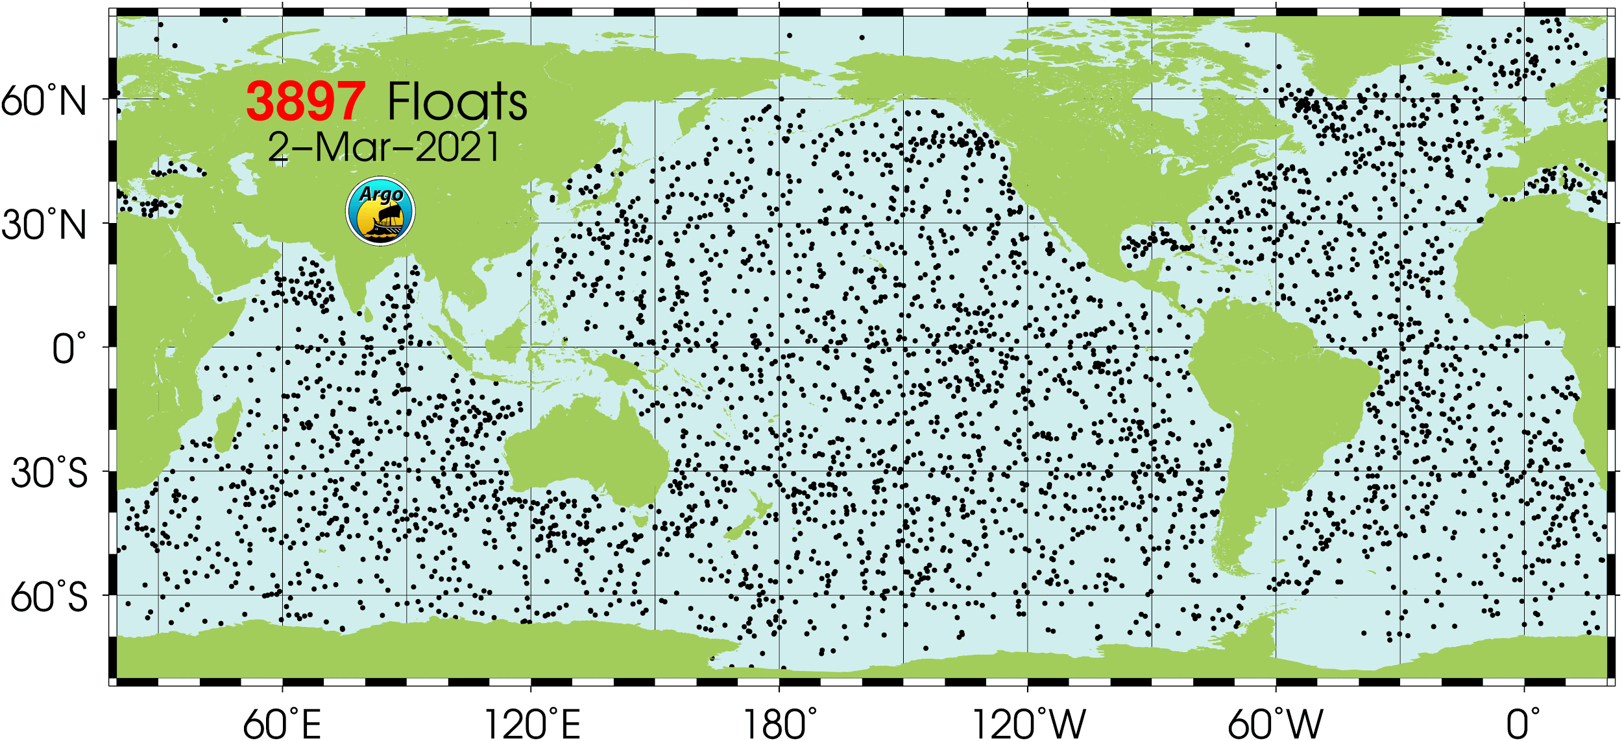
ARGO: What, Where, When
ARGO is a system of buoys that go down into ocean and measure temperature, salinity, and other variables of ocean water. They are found all over the globe.
The buoys are down for ~10 days, and can drift up to 100 kilometers on each dive.
After their drift, buoys begin an ascent, during the ascent measurements such as temperature, pressure (a proxy for depth), and salinity are taken
After the ascent the buoys surface and relay all of the data via satellite before beginning the cycle again

Slide 3
Cleaning and Formatting
Once received by satellite, float data is transferred to data assembly centers, following a quality control procedure and NetCDF formatting, float data is then uploaded to various public facing ftp and https servers.
A simple bash script, using the wget utility, was used to iterate over subdirectories and download all pertinent NetCDF files corresponding to float data gathered from the Pacific Ocean.
Our data pipeline consists of functions that take in multiple netCDF files, appropriately subset to any specified latitude and longitude and then select any specified measurements taken by the buoys.
NetCDF Read-In (64 Variables/Dive)
Filter in R (5 Location/Time/Buoy Variables and 3 Covariates)
Covariate CSV
Key Variable Data
Measurement Data
The Covariate CSV
1 row per observation of measurement data, with a unique key of Julian Date and buoy number
1 row per buoy/date pair
1 column per buoy/date pair

Slide 4
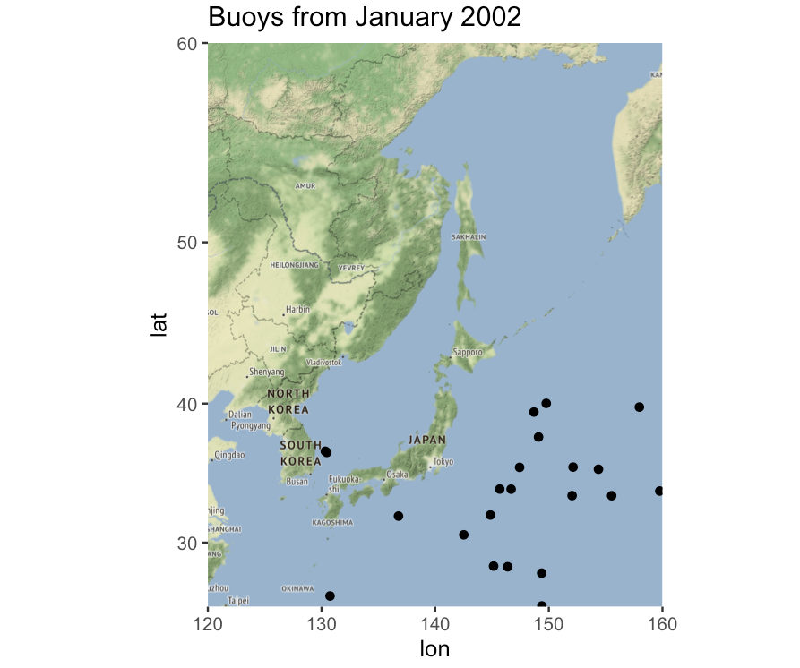
Lots of Data: How Much is Useful?
Around 80% of buoys that are recorded as having surfaced in these files have recorded NA’s for all their measurement data.
Sparsity was a large issue in our data. Each buoy is alone in a very large region.
No matter which model we chose, we would have to account for the fact that the data is sparse. We assumed smoothness between buoy measurements across space.
This continuity assumption is made in many oceanography papers.
We have data over many years, and more recent years have more buoys.

Slide 5
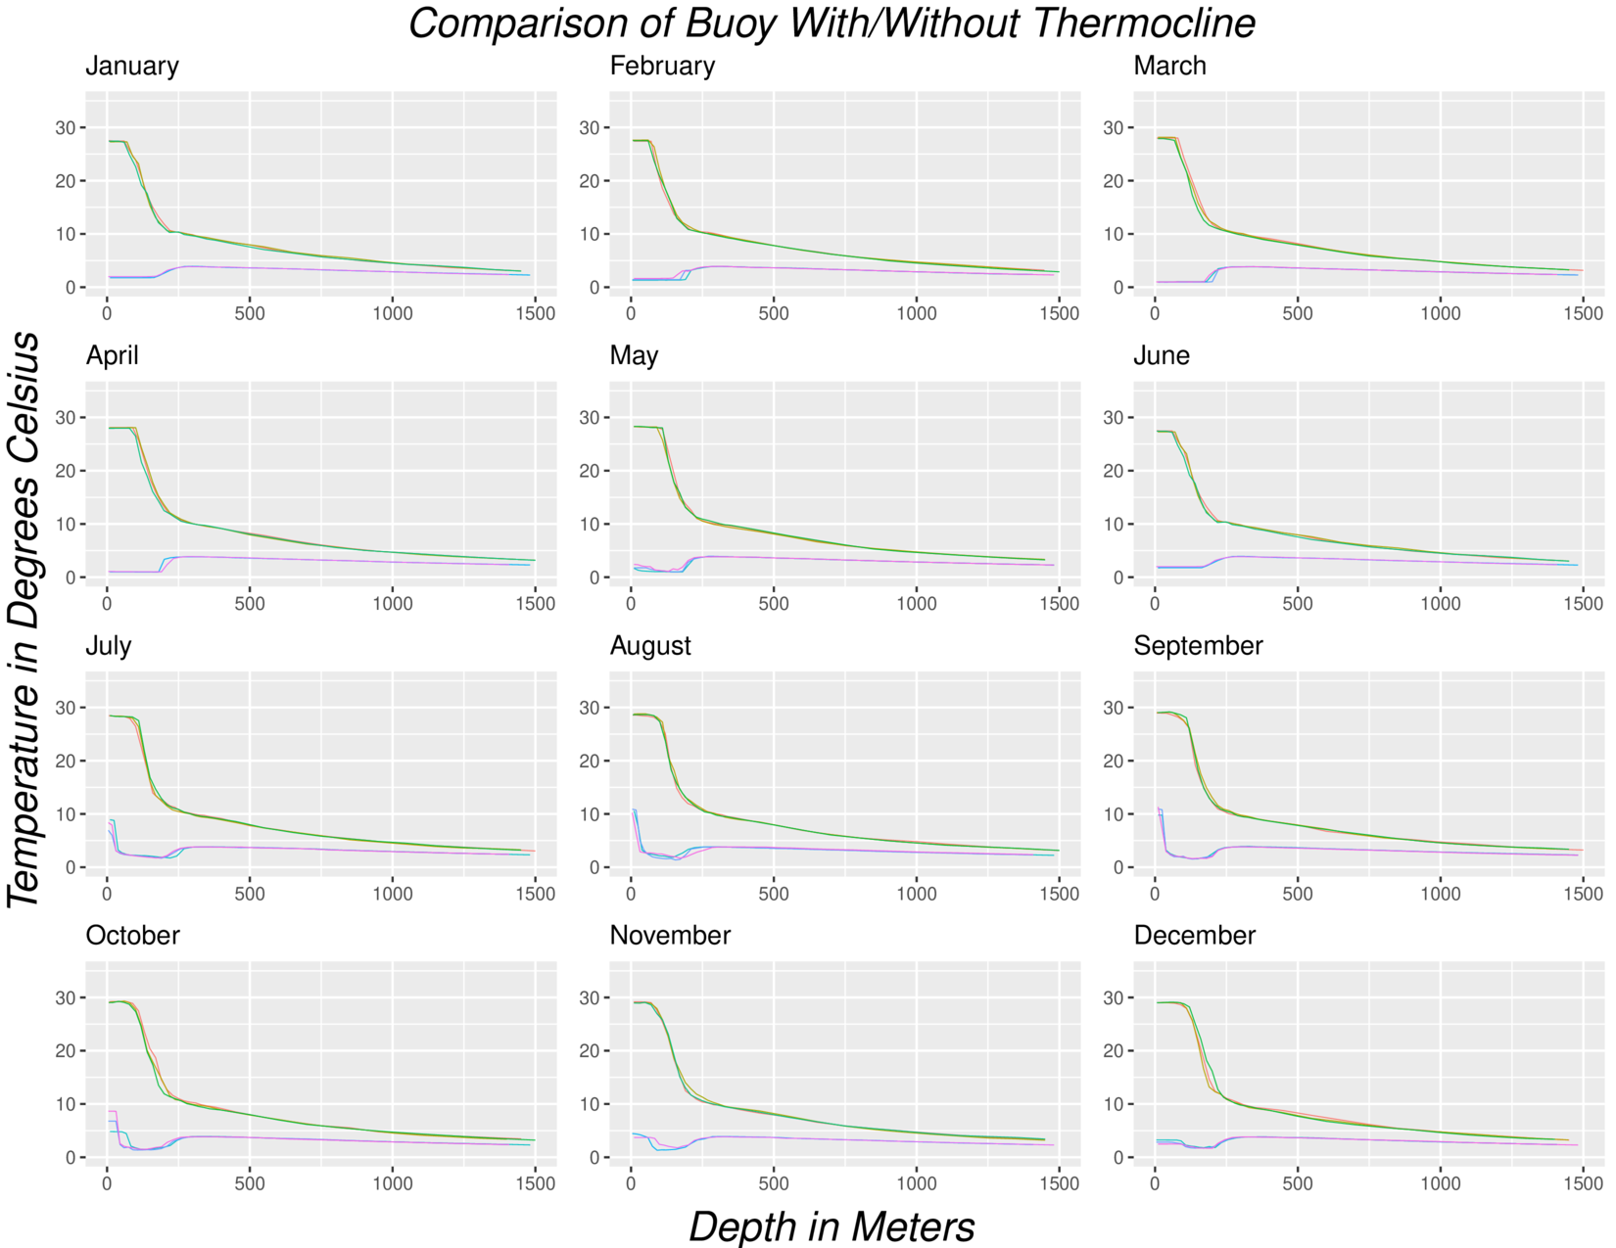
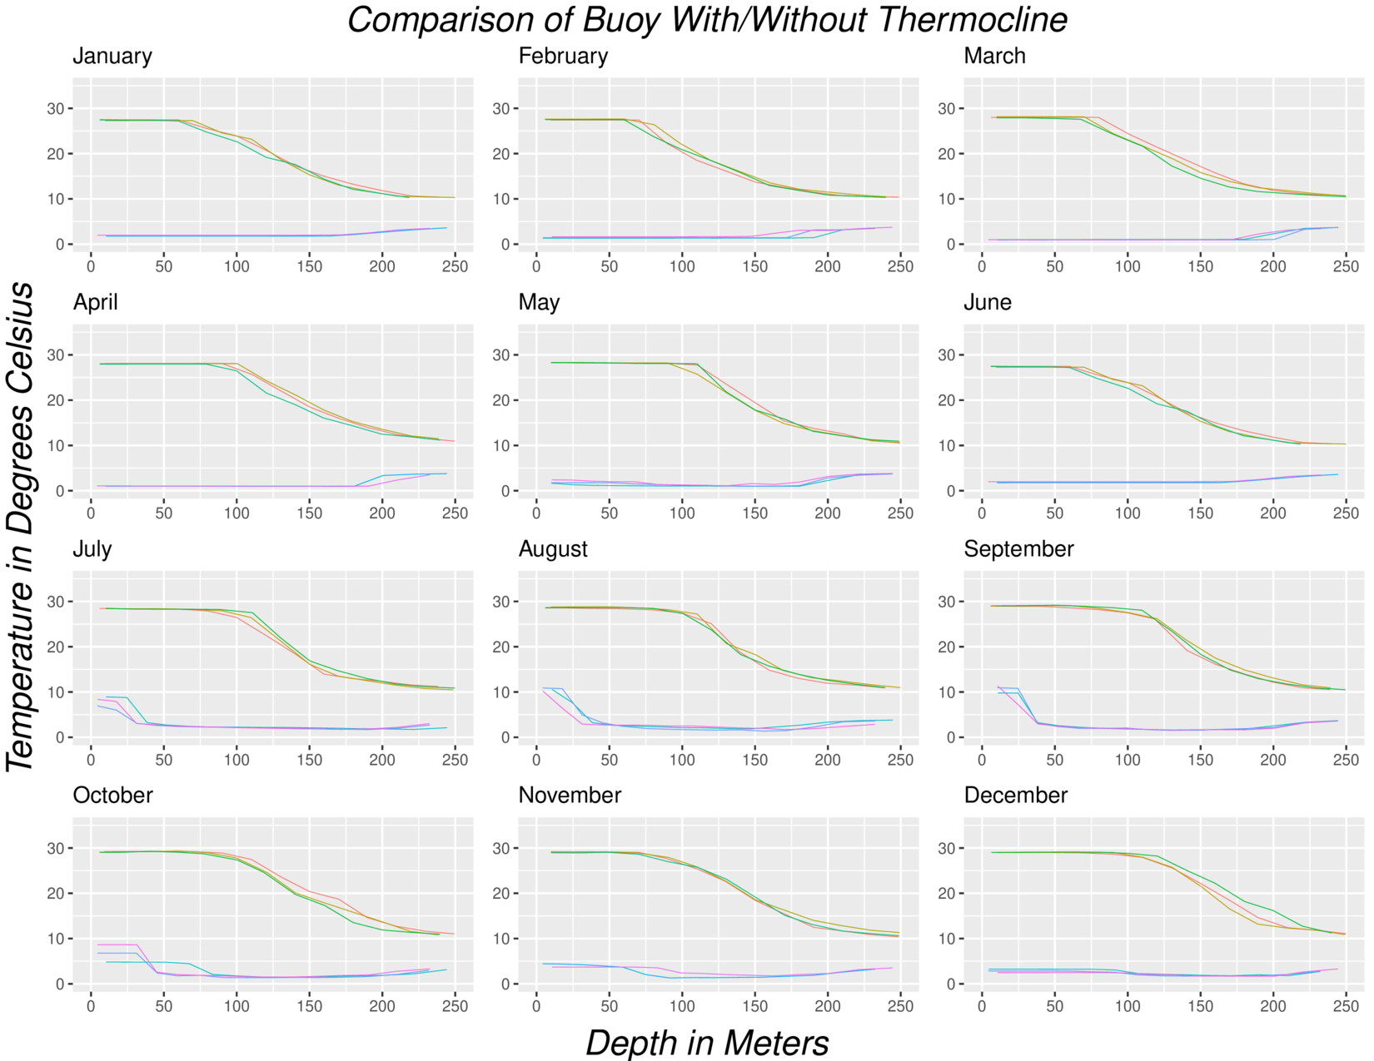
Thermocline Intro
Thermocline: Steep drop in temperature over (relatively) small change in depth.
Green Buoys: Low latitude, tropical ocean waters. Blue Buoys: High latitude, subarctic ocean waters
Green buoys have a thermocline, while blue buoys do not.
Left Plot: x-axis goes all the way to 1500 meters depth. Right Plot: Same data, but x-axis stops at 250 meters depth.

Slide 6
Goal and Hypothesis
Initial Goal: Try to predict typhoon likelihood given a model of initial thermocline depth with latitude/longitude.
Hypothesis: Deeper thermoclines would lead to a higher likelihood of typhoons occurring.
Challenge: Many locations typhoons don’t happen despite the same thermocline conditions.
Simplification: Group into bins, i.e cut our region into small boxes (1° Latitude by 1° Longitude), and study Typhoons~Thermocline Depth with a binned approach.
Simplified Goal: Instead of prediction and causality, try to observe correlation between thermocline depth (during typhoon season only) and number of typhoons.
Simplification would still be helpful and actionable, especially if we can observe correlation over multiple years.
Conclusion (Big Picture): Our result was mixed. We did find some interesting correlation, but there are some patterns in the data that we weren’t able to explore further, particularly in months outside typhoon season. Details in coming slides.

Slide 7
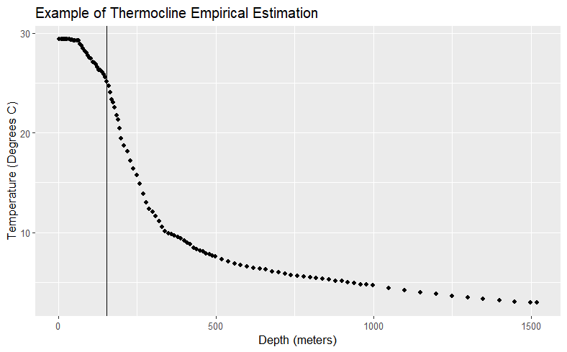
Thermocline Depth: Creating a Statistic
Challenge: Thermoclines don’t consistently start the same way.
In the top layer of water (called the epipelagic zone), temperature is sometimes flat, sometimes descending. Start of thermocline is also variable.
Debate on best practices for empirically measuring the thermocline are ongoing.
For our project, used variable representative isotherm: a method created by Wang et. al (2000), modified, and empirically tested by Fiedler (2010).
Most robust method in Fiedler’s empirical paper.
Biggest weakness is that it is not tested on latitudes above 40 degrees or surface temperatures below 10 ℃. On our data, these produced terrible outputs.
Weaknesses didn’t affect our project, since we focused on tropical areas where typhoons start, namely below 40 degrees latitude and with surface temperatures close to 30 ℃
TT: Thermocline Temperature
T(MLD): Temperature of Mixed Layer Depth (defined as Surface Temp. - 0.8)
T(400m): Temperature at depth of 400 meters

Slide 8
The Model Roadmap
Step 0: Obtain the Thermocline Depth
at points with buoy measurements
Step 1: Model the Thermocline Depth at every point using GAM
Step 2: Model the relationship between typhoons and Thermocline Depth
We use the variable representative isotherm (VRI) method, to get the thermocline depth at every buoy dive.
This gives sparse point data of thermocline depth around our region.
Using the VRI method obtained thermocline depths we fit a GAM to predict thermocline depth at any latitude longitude point.
This GAM uses data from multiple months and multiple years.
We bin our area of interest and estimate the thermocline depth at the centroid of each bin using the GAM.
We model the counts of typhoons that begin in each bin via negative binomial GLM.

Slide 9
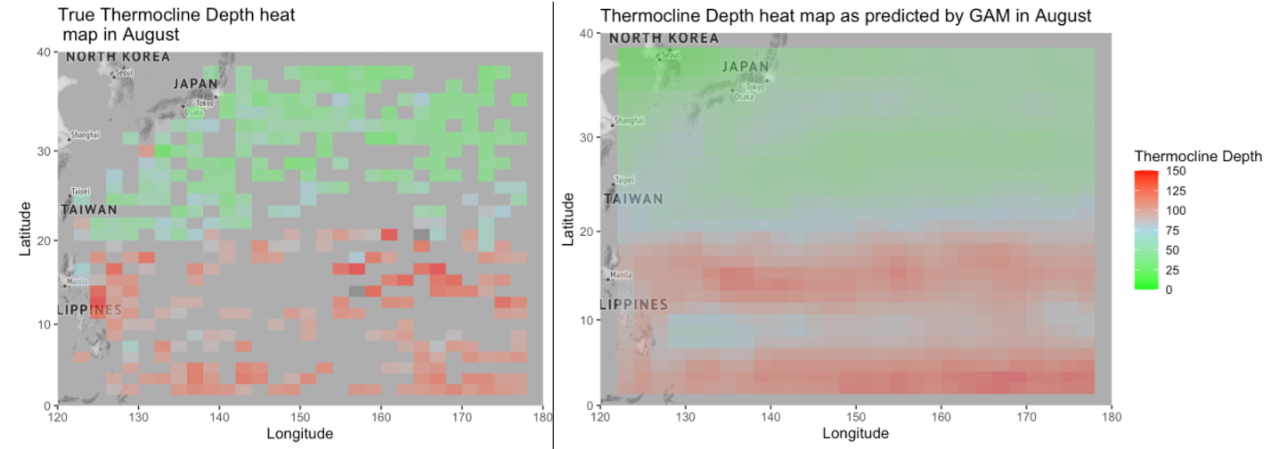
Step 1: Continuous Thermocline Depth Model
The goal of the first model is to go from sparse point data (Left) to a continuous model (Right)

Slide 10
GAM overview
We use a generalized additive model (GAM) to model the thermocline depth continuously
GAMs are an extension of generalized linear mixed models to model more complex nonlinear relationships.
GAMs are sums of penalized splines. We choose the type of spline, the basis dimension and the degree of smoothing.
These are commonly used for spatial data, since we can explicitly model the spatial relationship through specific penalized splines for spatial data.

Slide 11
Our GAM for thermocline depth
Although we are more interested in typhoon season months (July-October), we model with all the months because previous months seem to be informative about other months.
To do this we model month as a random effect, as well as an interaction term with Latitude.
The form of our model is:
We model with a sphere spline for the longitude and latitude interaction, a default penalized thin plate spline for the latitude and random effects for the other two functions

Slide 12
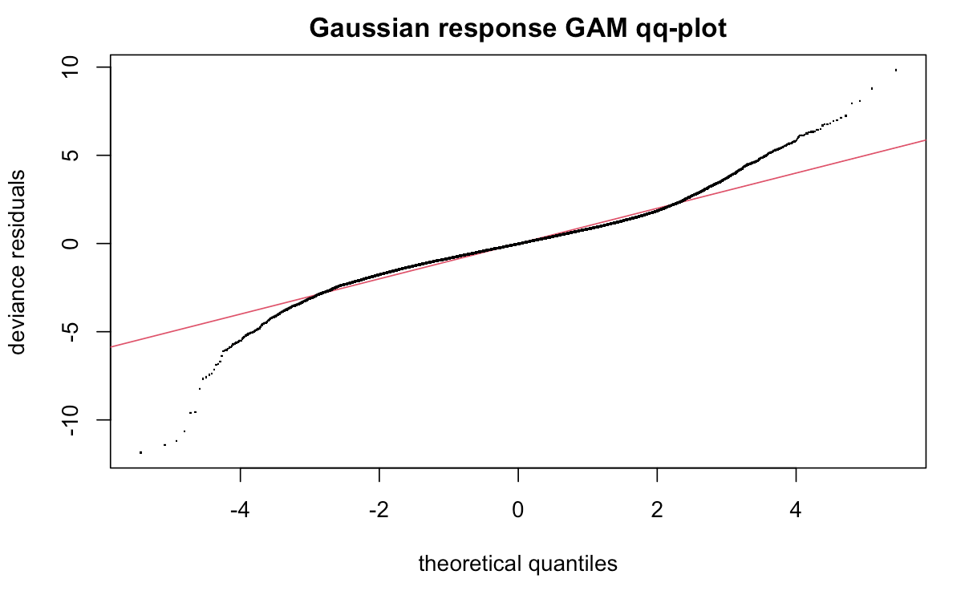
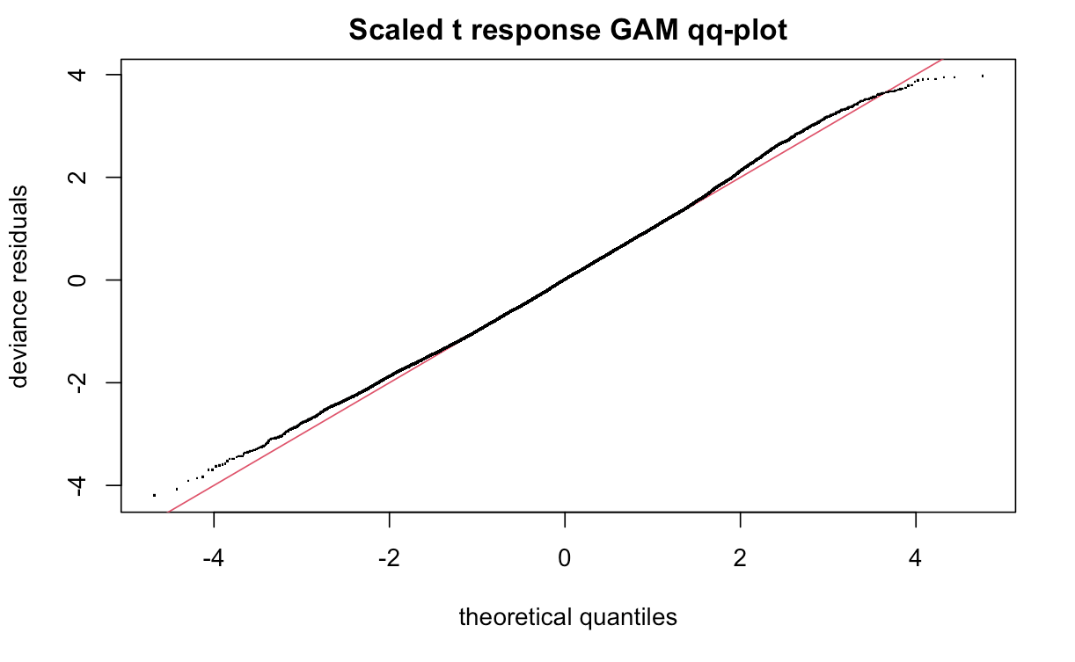
GAM checking and results
Initially we modeled with a Gaussian response but we noticed heavy tails in our residual plots
We decided to model with a scaled t distribution and received much better results

Slide 13
GAM model check and criticisms
The model passes all basic GAM checking criteria. We have a proper response as shown in the qq-plots and our residuals follow the appropriate patterns.
In terms of predictive power we observe a root mean squared error on test data of: 31.50402 m
The error is not consistent among the months as March, April, and May have near double the error as in August.
The winter months are accurate to the buoy data, but give unintuitive thermocline results.
Winter months have deep thermoclines in temperate zones (Latitude 20° to 40°), but no typhoons! There is clearly more going on than simply thermocline depth.
For instance, these months/regions have low surface temperatures, and small differences between surface temperatures and deep temperatures. We only care about summer months, so quirks in winter months don’t affect our upcoming typhoon analysis.
For our thermocline/typhoon analysis coming up, we were careful to only look at months in typhoon season.

Slide 14
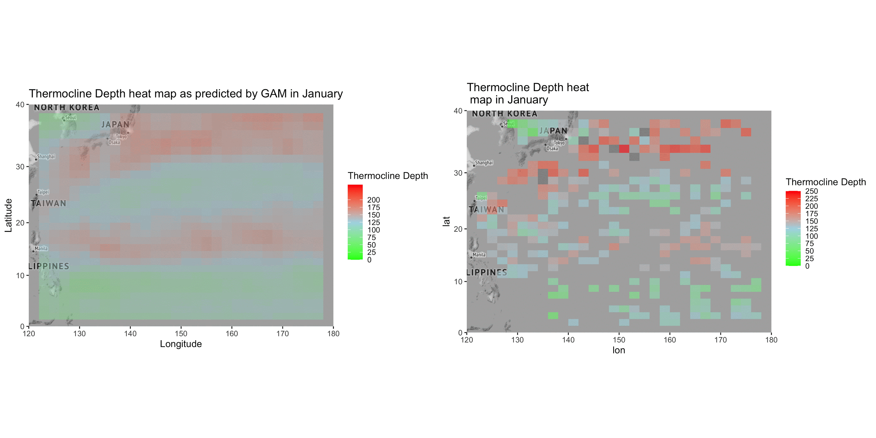

Slide 15
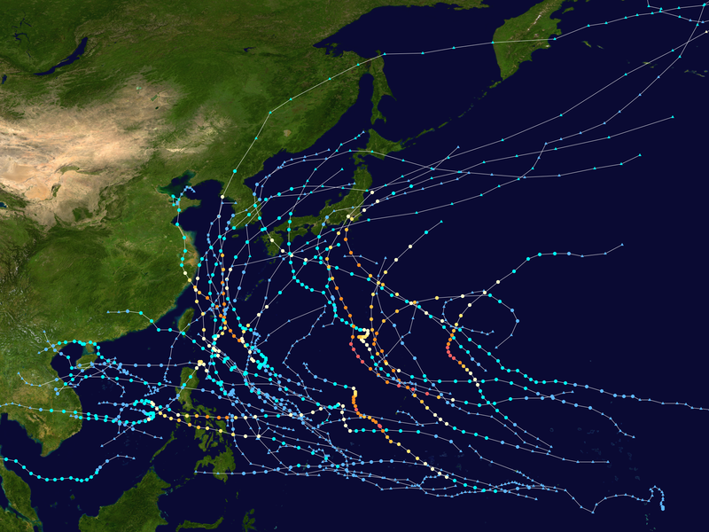
Typhoons
Pacific typhoon season is between May and November peaking in August and September
Thermocline depth and typhoons are intertwined: the depth of the thermocline can indicate the risk of a cyclone forming.
The Navy’s meteorological/oceanographic command (CNMOC) keeps detailed records of every typhoon in the northwestern Pacific region dating back to 1945
2019 Pacific typhoon season

Slide 16
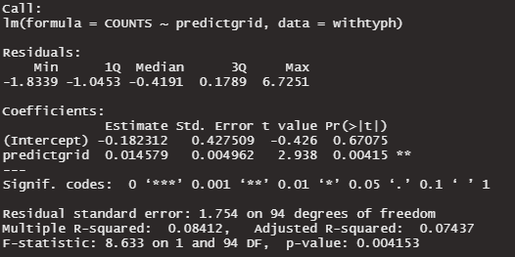
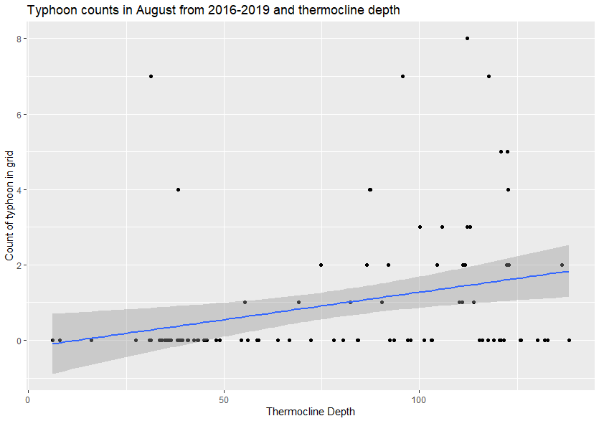
Step 2: Typhoon and Thermocline Depth
Initial Attempt: We initially used a simple linear model to look at Thermocline Depth versus the # of Typhoons in each of our bins for the month of August (peak of typhoon season).
Model output is on the right, plot of the same data on the left, with the line of best fit.
While the model says there is statistical significance, the plot of the points shows that the relationship is clearly non-linear. Linear model is probably the wrong choice.
Due to the count data and overdispersion, we attempt a negative binomial model as our next step.

Slide 17
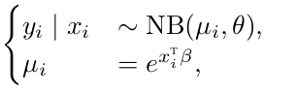
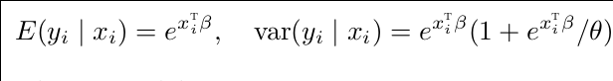
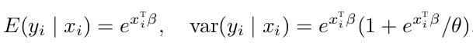
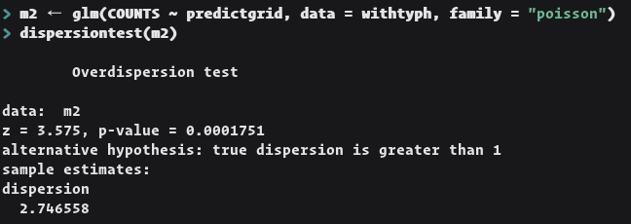
Negative-Binomial Regression
The negative binomial model models count data but allows for overdispersion; when the variance is larger than the mean.
We test and find that we have overdispersion so a poisson model is inappropriate.

Slide 18
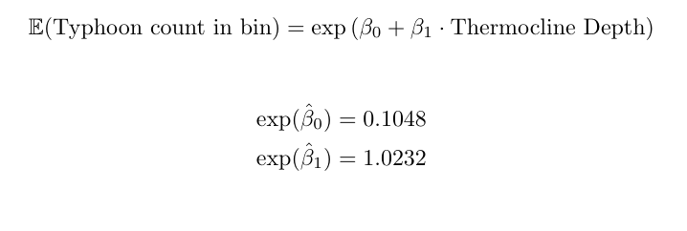
NB model and results
Interpretability:
The exponentiated intercept represents the average typhoon count in a bin.
The exponentiated slope represents the multiplicative increase in expected count given a 1m increase in thermocline depth.
We can interpret for this basic model that a meter thermocline depth increase is correlated with a 2% increase in the number of typhoons that appear in said bin.

Slide 19
Conclusion and Next Steps
We found a correlation between thermocline depth in the month of August and the number of typhoons starting during typhoon season.
We identified other variables and possible confounders that would be useful to account for are:
Surface Temperature
Difference between surface temperature and deep temperature
Wind speed above water
Atmospheric pressure
The ARGO dataset is not sufficient to fully answer our question. With additional time, combining it with wind and atmospheric data could help improve the model.

